Slide 1



IIFL ONE – FACTOR INVESTING
15 September 2021

Slide 2
CONTENTS
What?
Why?
Who?
Which?
When?
Where?
Common Questions

Slide 3

WHAT IS FACTOR INVESTING?

Slide 4
WHAT IS FACTOR INVESTING?
WHAT ARE FACTORS?
A factor is a quantitative way of expressing a qualitative theme
Factors are well-defined characteristics shared by investment assets
WHAT ARE THE MAIN FACTOR TYPES?
Macro e.g. real rates, inflation, economic growth, credit, emerging markets, liquidity—explain variation of returns between asset classes
Style e.g. value, momentum, quality, size, carry—explain variation of returns within an asset class
WHAT IS FACTOR INVESTING?
Defining and then systematically following a set of rules that produce diversified portfolios
WHAT ARE THE PERTINENT QUESTIONS?
Did exposure to the factor yield profits in the past?
If so, what are the reasons for the performance of this factor?
Will it (continue to) make money, net of frictional costs, in future?
WHAT ARE ITS CRITIQUES?
Data mining has led to what John Cochrane has referred to as a “factor zoo”
Numerous factors in the consideration set, comprising those that worked in the past, but are not “real”
WHAT ARE THE RISKS?
Investing in factors that prove fictitious entails both opportunity and underperformance costs that are real

Slide 5
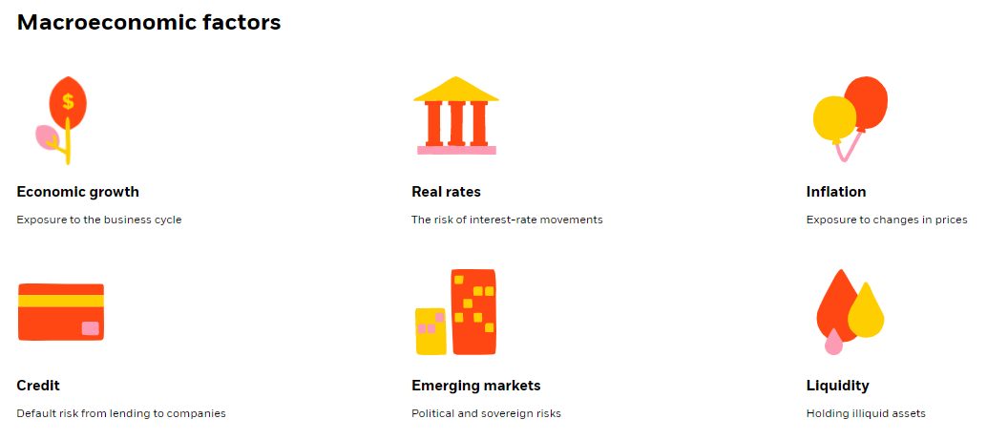
MACRO FACTORS
Source = https://www.blackrock.com/us/individual/investment-ideas/what-is-factor-investing

Slide 6
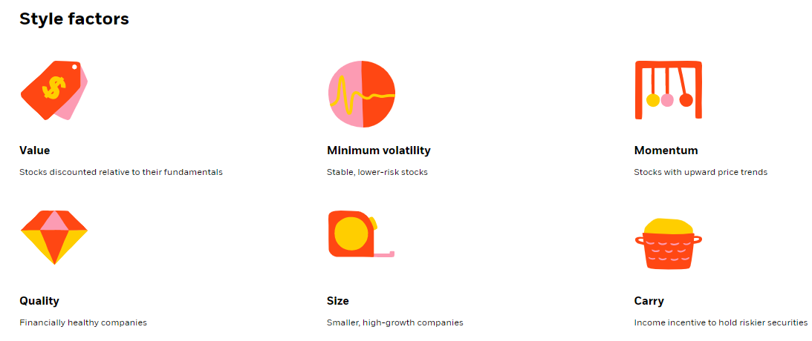
STYLE FACTORS
Source = https://www.blackrock.com/us/individual/investment-ideas/what-is-factor-investing

Slide 7
WHY HAS FACTOR INVESTING EXPANDED?

Slide 8
WHY THE APPEAL (OR LACK THEREOF)?
WHY ARE FACTORS GAINING IN POPULARITY?
Promise of fulfilling all three main investor goals:
Outperformance;
Reduced volatility; and
Diversification.
So-called alternative assets viz. private equity, hedge funds, real estate investment trusts and infrastructure have a relatively high correlation with equities; among traditional alternatives, commodities and timberland are the only two that are uncorrelated
Non-traditional diversification i.e. via factors rather than asset classes
Lower fees—don’t pay active fees for factor-based returns! And yet an adopt active investing approach…
Tax-efficiency
WHY HAS FACTOR INVESTING BECOME UBIQUITOUS?
New technologies have facilitated
Ever-cheaper computing power, and
Easy access to an expanding assortment of data sources,
and democratized factor investing.
WHY DOES FACTOR INVESTING WORK?
Risk appetite e.g. higher carry for higher credit/sovereign risk
Structural impediments e.g. regulations restricting investment of pension funds, or benchmarks used to govern insurance asset pools
Behavioral reasons e.g. preference for safe-harbor assets by risk-averse savers
These are also the very reasons why everyone does not use factor investing!!!

Slide 9
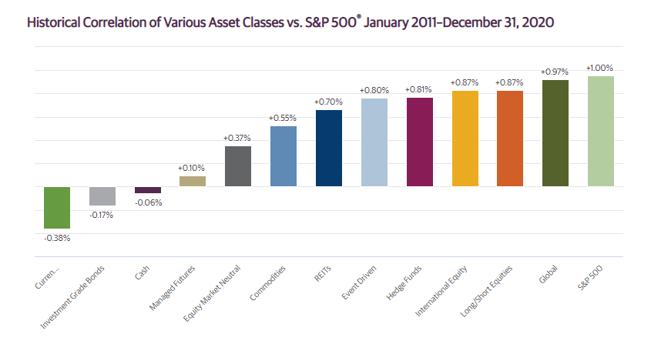
CORRELATIONS OF ASSET CLASSES
In contrast with asset classes, investment factors have—by design—relatively lower pairwise correlations, and so, yield better diversification.
N.B. Labels near the bars in the graph are erroneously shown as percentages. Correlation basis monthly total returns of each representative index e.g. MSCI World Net TRI for Global, MSCI EAFE Index for International Equity etc. The full list may be seen at the source link.
Source = https://www.guggenheiminvestments.com/mutual-funds/resources/interactive-tools/asset-class-correlation-map

Slide 10
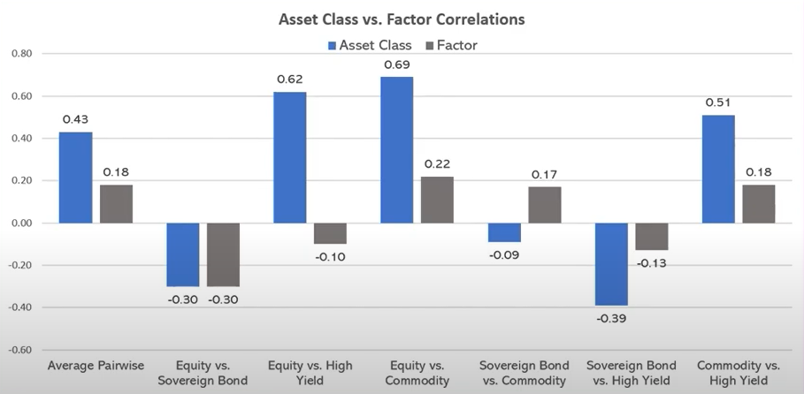
FACTORS HAVE LOW CORRELATION BY DESIGN
Source = https://www.youtube.com/watch?v=py6DLYhjetM

Slide 11
WHO ARE ITS BEST-KNOWN EXEMPLARS?

Slide 12
PROTAGONISTS & PRINCIPAL PROPONENTS
WHO WERE THE FIRST PRACTITIONERS?
Barr Rosenberg, a former Berkeley University economics professor and founder of Barra (later acquired by MSCI), is considered the father of quantitative investing
Richard Grinold and Ronald Kahn—stressed the use of factors that represented the recognized key investment attributes e.g. momentum, size, liquidity, growth, value, volatility, and financial leverage
WHO ARE MODERN-DAY PROPONENTS?
BlackRock leads the field among present purveyors of factor or rules-based investing
Personalities:
Andrew Ang (BlackRock)
Rob Arnott (Research Affiliates)
Cliff Asness (AQR)
David Booth (Dimensional Fund Advisors)
WHO’S WHO IN THE INDIAN CONTEXT?
Both the BSE and the NSE publish “strategy” indices via their index affiliates
MSCI has 6 subsets of their MSCI India Index that are factor-tilted variants viz. Value, Growth, Momentum, Quality, Minimum Volatility and High Dividend Yield
UTI Nifty 200 Momentum 30 ETF
Axis Quant Fund, DSP Quant, Tata Quant Fund, and the (upcoming) IIFL Quant Fund all follow rules-based portfolio construction with tilts towards a combination of factors

Slide 13
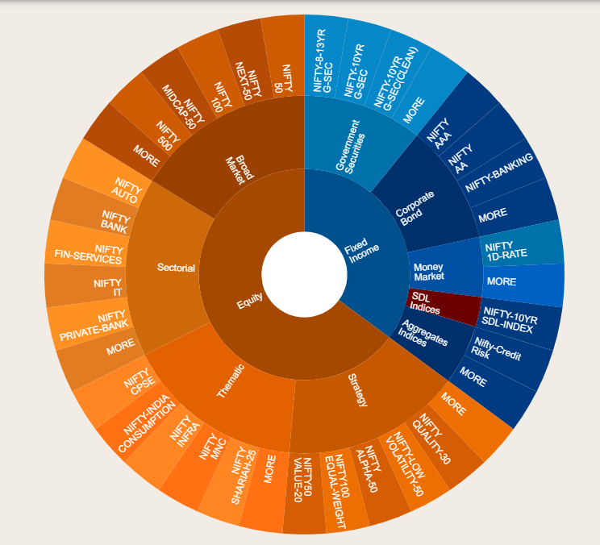
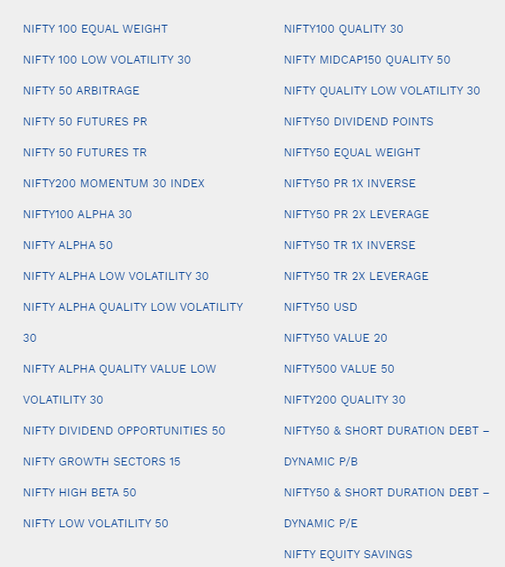
NSE STRATEGY/FACTOR INDICES
Source = https://www.niftyindices.com/

Slide 14
WHEN DID IT ALL START?

Slide 15
A TIMELINE…
WHEN DID IT START?
Factor investing is an extension of the Capital Asset Pricing Model (a.k.a. CAPM)
CAPM was put forth by Jack Treynor (1961), William F. Sharpe (1964), John Lintner (1965) and Jan Mossin (1966) independently
The 1-factor CAPM
r_{i} – R_{f} = β_{i} * (R_{Market} – R_{f})
SEQUEL TO THE CAPM
Stephen Ross proposed “Arbitrage Pricing Theory” in 1976 and extended the single-factor framework to multiple factors, but without specifying the factors
r_{i} – R_{f} = λ_{i1} f₁ + λ_{i2} f₂ + … + λ_{in} f_{n}
WHEN DID IT EVOLVE FURTHER?
Eugene Fama and Kenneth French put forth the three-factor model—namely β, size and value—in 1993
r_{i} – R_{f} = β_{i} * (R_{Market} – R_{f}) + β_{size} RP_{SMB} + β_{val} RP_{HML}
Carhart extended it to a four-factor model—added momentum—in 1997
r_{i} – R_{f} = β_{i} * (R_{Market} – R_{f}) + β_{size} RP_{SMB} + β_{val} RP_{HML} + β_{mom} RP_{UMD}
Eugene Fama and Kenneth French extended their three-factor model—with profitability and investment—in 2015, but in the intervening period, there was a proliferation of such models and their vendors e.g. MSCI Barra, Axioma, Northfield etc.
r_{i} – R_{f} = β_{i} * (R_{Market} – R_{f}) + β_{size} RP_{SMB} + β_{val} RP_{HML} + β_{profit} RP_{RMW} + β_{inv} RP_{CMA}

Slide 16
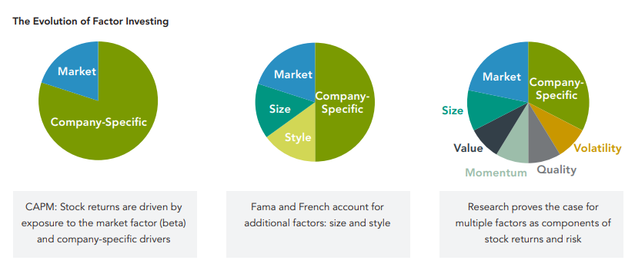
A TIMELINE…
Source = https://www.fidelity.com/bin-public/060_www_fidelity_com/documents/fidelity/fidelity-overview-of-factor-investing.pdf

Slide 17
WHICH FACTORS WORK?

Slide 18
WHICH FACTORS WORK?
WHICH FACTORS WORK?
Many of the seemingly separate factors that work are variations on a theme
WHICH TESTS MUST A FACTOR FULFILL TO BE CONSIDERED REAL?
Researchers/practitioners need to subject any new factor investing candidates to intuitive and specific tests:
Persistence: reasonably reliable historical record of returns across different time periods and economic regimes
Pervasiveness: works across a variety of regions/countries and industries/sectors
Robustness: operate without failure and perform well through a variety of market and economic cycles
Intuitiveness: existence of the factor premium makes economic sense, either for structural or behavioral reasons
Investability: possible to implement and make money
IF SO…
Past glory vs. future potential—has its day passed, or will it continue to deliver?
Is it already covered via proxy in an existing theme?
WHICH ARE THE MAJOR THEMES?
Equity: Beta, Value, Size, Momentum, Quality
Fixed Income: Term, Carry

Slide 19
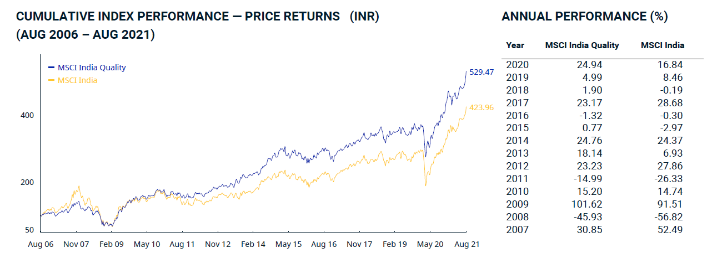
FACTOR PERFORMANCE IN INDIA—QUALITY (Price)
Source = MSCI website

Slide 20
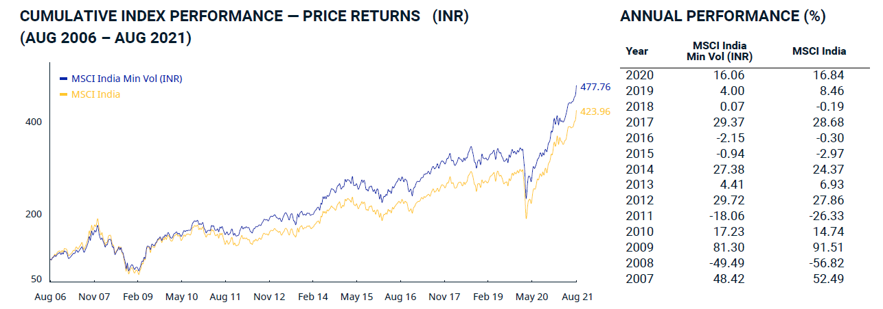
FACTOR PERFORMANCE IN INDIA—MIN VOL (Price)
Source = MSCI website

Slide 21
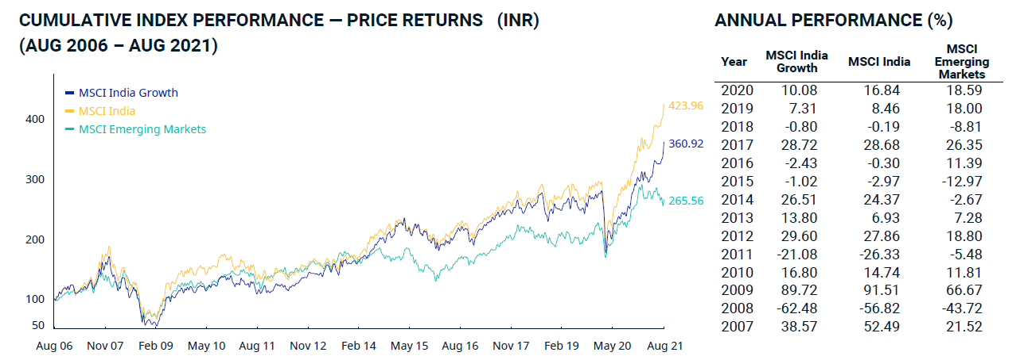
FACTOR PERFORMANCE IN INDIA—GROWTH (Price)
Source = MSCI website

Slide 22
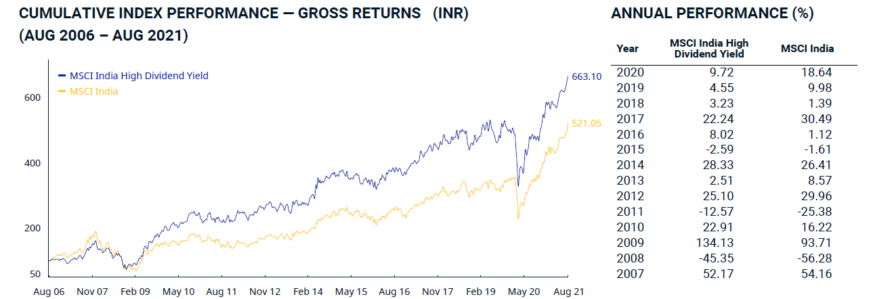
FACTOR PERFORMANCE IN INDIA—HIGH DIV YLD (TR)
Source = MSCI website

Slide 23
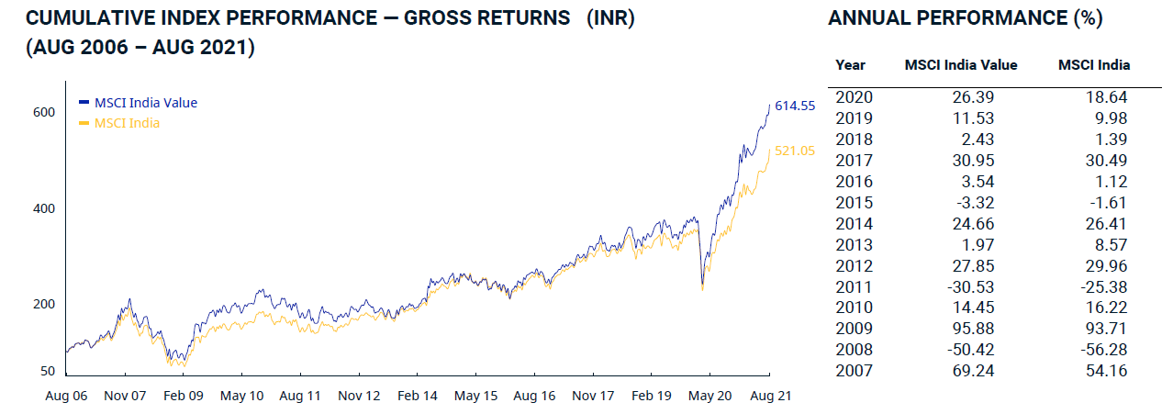
FACTOR PERFORMANCE IN INDIA—VALUE (TR)
Source = MSCI website

Slide 24
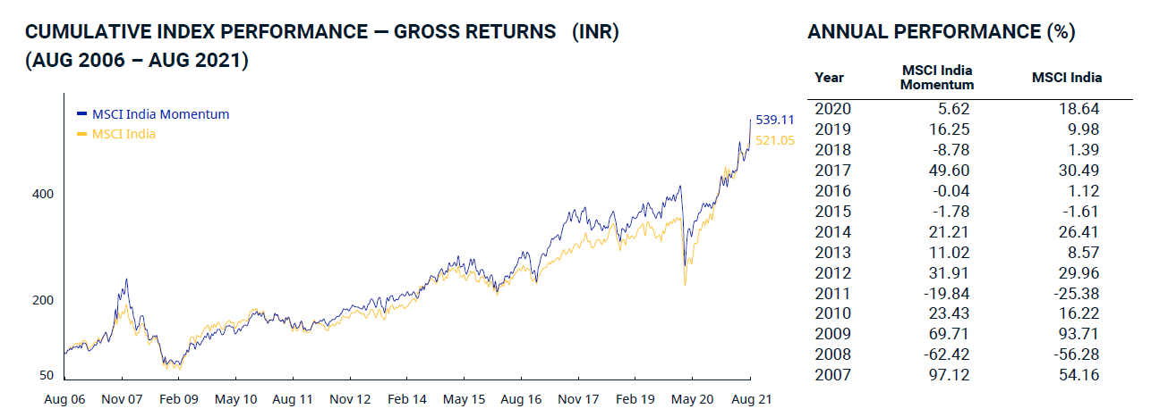
FACTOR PERFORMANCE IN INDIA—MOMENTUM (TR)
Source = MSCI website

Slide 25
WHERE MAY ONE USE FACTORS STRATEGIES?

Slide 26
WHERE MAY ONE USE FACTORS STRATEGIES?
WHERE MAY FACTORS BE HARNESSED?
Across retail as well as institutional portfolios
Across equity, fixed income, and multi-asset portfolios e.g. carry in bonds/currencies and momentum in equities during risk-off regimes, and quality during risk-on
To substitute or to complement existing investments, whether active or passive
Across developed as well as emerging markets (although the efficacy of a given factor will vary)
In a multi-factor portfolio setting or in multiple single-factor portfolios
In traditional asset management e.g. mutual funds (in a long-only setting) as well as in lesser regulated investment vehicles e.g. hedge funds (in a long-short setting)

Slide 27
COMMON QUESTIONS

Slide 28
COMMON QUESTIONS
WHY DOESN’T EVERYONE USE FACTOR INVESTING?
WHY HAS THE VALUE FACTOR NOT PERFORMED?
WILL WIDESPREAD ADOPTION NULLIFY THE BENEFITS?
WHICH FACTORS PERFORM UNDER WHICH CONDITIONS?
or
HOW DOES ONE DO FACTOR TIMING?
IS FACTOR INVESTING ACTIVE INVESTING?
WHAT IS THE DIFFERENCE BETWEEN SMART BETA AND FACTOR INVESTING?

Slide 29
THANK YOU

